Slide 1
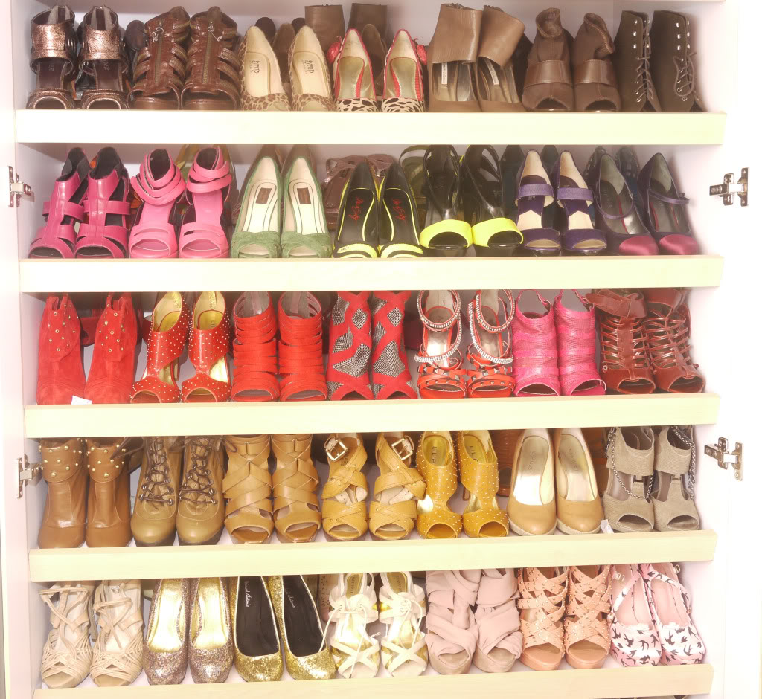

Slide 2
THE TEAM
Lead ME
Dalton C. Brown
Mechanical Engineering Student
Team Leader
Kali J. Nelson
Mechanical Engineering Student
Financial Advisor
Olapido A. Jegede
Mechanical Engineering Student

Slide 3
The Problem
THE PROBLEM
Heels cause foot pain after extended periods.
9 in 10 women have walked barefoot due to heels.
Women carry an extra pair of shoes.
3

Slide 4
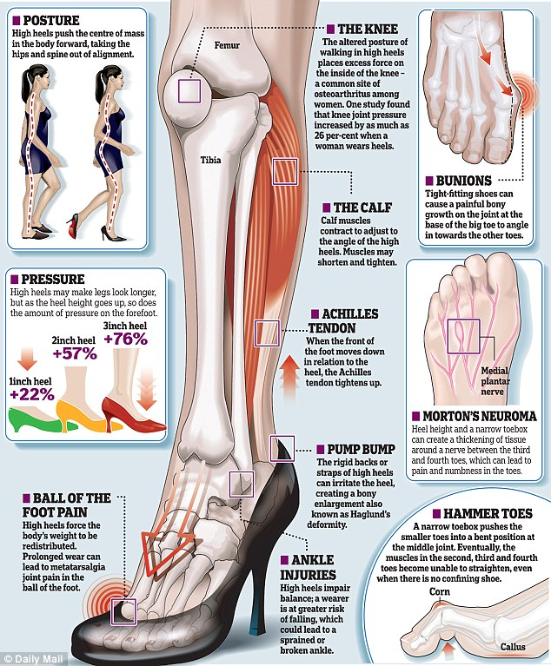
THE PROBLEM
The Problem
Short term and long term heel use can lead to a variety of medical conditions.
Heels cause unnatural posture.
Pressure on forefoot is increases as heel height increases.
4
4

Slide 5
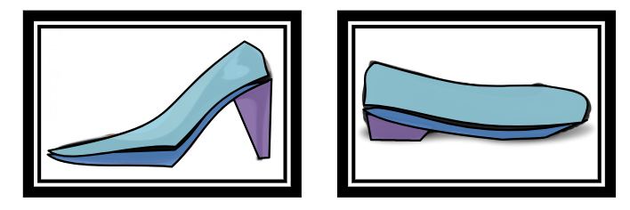
THE DESIGN PROBLEM
The Problem
Heel Mechanism
Changeable angle of inclination
Changeable exterior fabric around ball of foot
5
5
5

Slide 6
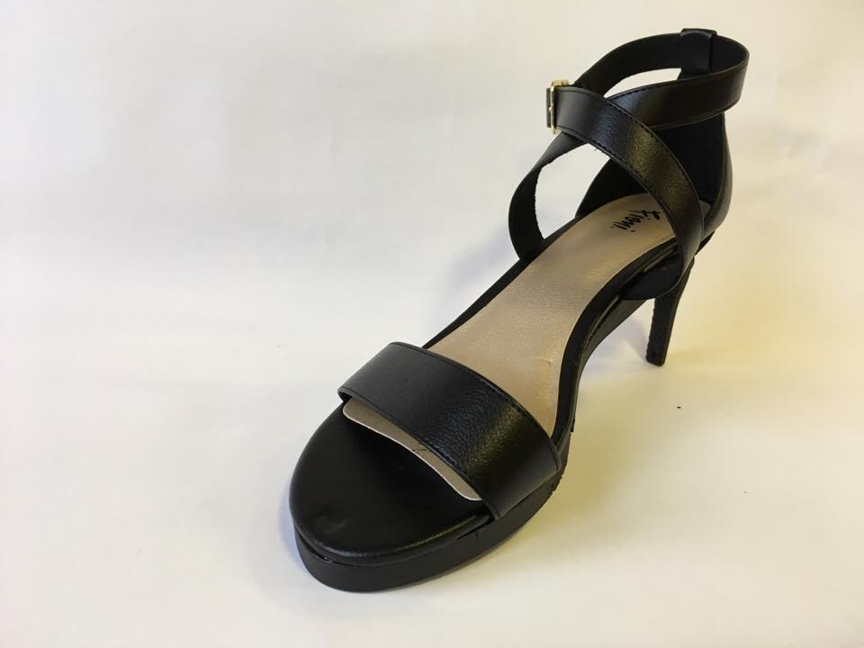
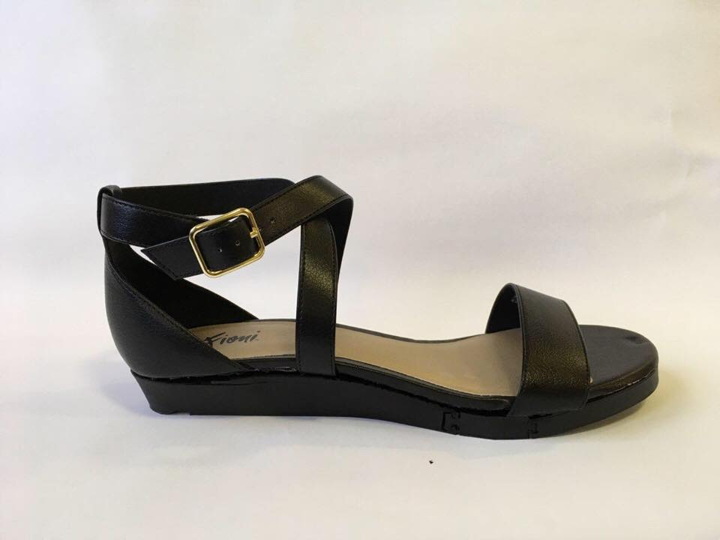
The Solution
THE SOLUTION
The Problem
A convertible heel that finds the balance between comfort and style.
6
6

Slide 7
THE VALUE
The Problem
Immediate relief from heel discomfort.
Can operate as shoe company or license our mechanism to existing brands.
Mechanism operation is not dependent on aesthetics of shoe.
7
7
7

Slide 8
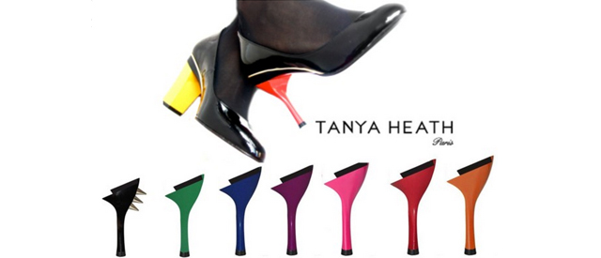
COMPETITORS
The Solution
The Problem
Tanya Heath has developed a clip on convertible heel.
Not commercially successful.
Allows for more product versatility.
8
8
8

Slide 9
THE MARKET
The Problem
WOMEN OF ALL AGES.
9
9

Slide 10
The Channels
MARKETING
The Problem
Partner with beauty bloggers, TV personalities.
Create a social media presence.
Develop website to communicate with others.
10
10

Slide 11
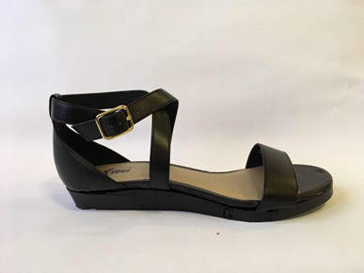
SUMMARY
The Channels
The Problem
Highly marketable
Need for this product
Appealing to women of all ages
11
11
11

Slide 12
SPECIAL THANKS
SPECIAL THANKS
The Channels
The Problem
FAMU-FSU College of Engineering
Our Sponsor, Dr. Michael Devine
Our Advisor, Dr. Simone Hruda
Our Professor, Dr. Shayne McConomy
Our Teaching Assistant, Daniel Tamayo
12
12
12
12
12
12
12
12

Slide 14
Customer Survey
Question Asked | Customer Response | Interpreted Need
How long does it take for your feet to start hurting when you wear heels? | 1 hour to 3 hours | The convertible shoe needs to be able to provide comfort easily after prolonged wear.
Have you ever walked barefoot because of the pain highs heels produced in your feet? | Yes | The convertible shoe needs to alleviate stress from the user's feet in its flat state.
Would you buy convertible high heel shoes? | Maybe | The convertible shoe needs to be fashionable, comfortable, and safe.

Slide 15
Customer Survey
How much would you be willing to pay for a convertible high heel? | $50 - $100 | The price of the convertible shoe should be below $100.
Would you want a heel that converted into multiple heights? | Yes | The convertible shoe needs to accommodate for multiple heights.
Would you want a design that did not have any detachable parts? | Yes | The convertible shoe should be able to convert between heights without the user having to remove a piece.
Which is more important to you? (No Detachable Part or Multiple Heights) | No Detachable Part (70%) Multiple Heights (30%) | It is more important to vary height as a singular component than as multiple components.

Slide 16
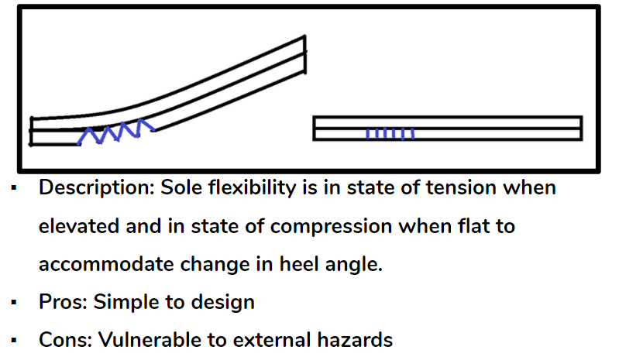
Flexible Sole Design

Slide 17
Metrics | Targets
Heel height in elevated state | Roughly 3 in.
Heel height in flat state | Less than ½ in.
Shoe size | 10 ½
Stays connected to foot under normal wear | Yes
Acceptable shoe traction to avoid slippage under normal wear | Yes
Easily transformable between states | Yes

Slide 18
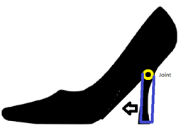
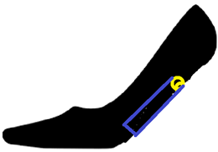
Heel Mechanism – Folding Heel Concept 1
Description: Uses a hinge or joint that allows the heel to pivot
Pros: Simple to implement, no removable parts
Cons: Requires thick sole

Slide 19
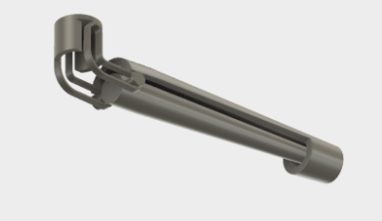
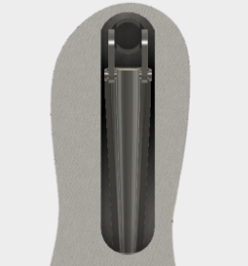
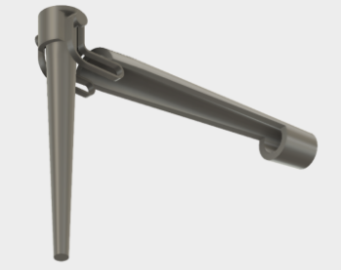
Mechanism Design

